Slide 1
Integer ambiguity resolution using a priori information on the baseline
Malik Boudiaf
AA 290
06/07/2018

Slide 2
Table of contents
Introduction and Problem statement
The integer ambiguity resolution
Constrained integer ambiguity resolution
Results
Conclusion – Ways forward

Slide 3
Table of contents
Introduction and Problem statement
The integer ambiguity resolution
Constrained integer ambiguity resolution
Results
Conclusion – Ways forward

Slide 4
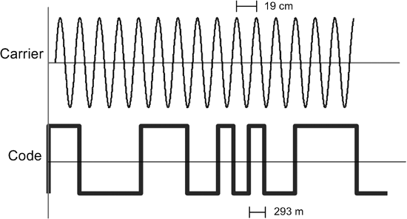
Introduction
GNSS-based navigation widely used in space applications
DiGiTaL project : GNSS-based navigation with goal to provide cm-mm level accuracy
Different levels of accuracy
Pseudo range : noise ≈ dm
Carrier phase : noise ≈ mm

Slide 5
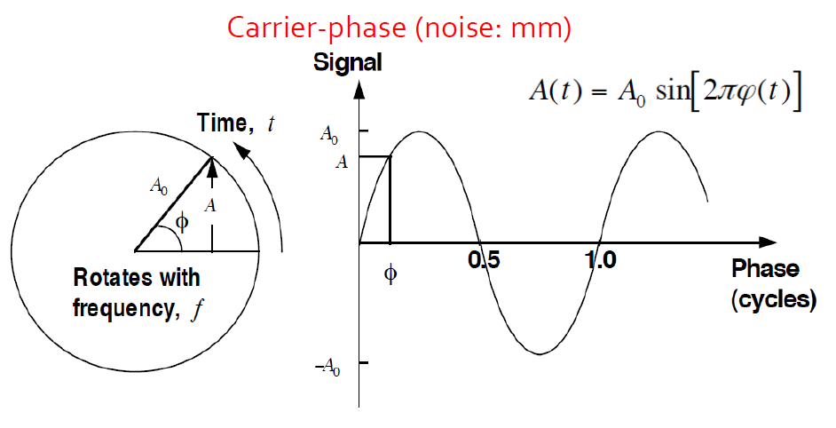
Carrier phase
Notes:
A good analogy to this is to imagine a measuring tape extending from the satellite to the receiver that has numbered markers every one millimeter. Unfortunately, however, the numbering scheme returns to zero with every wavelength

Slide 6
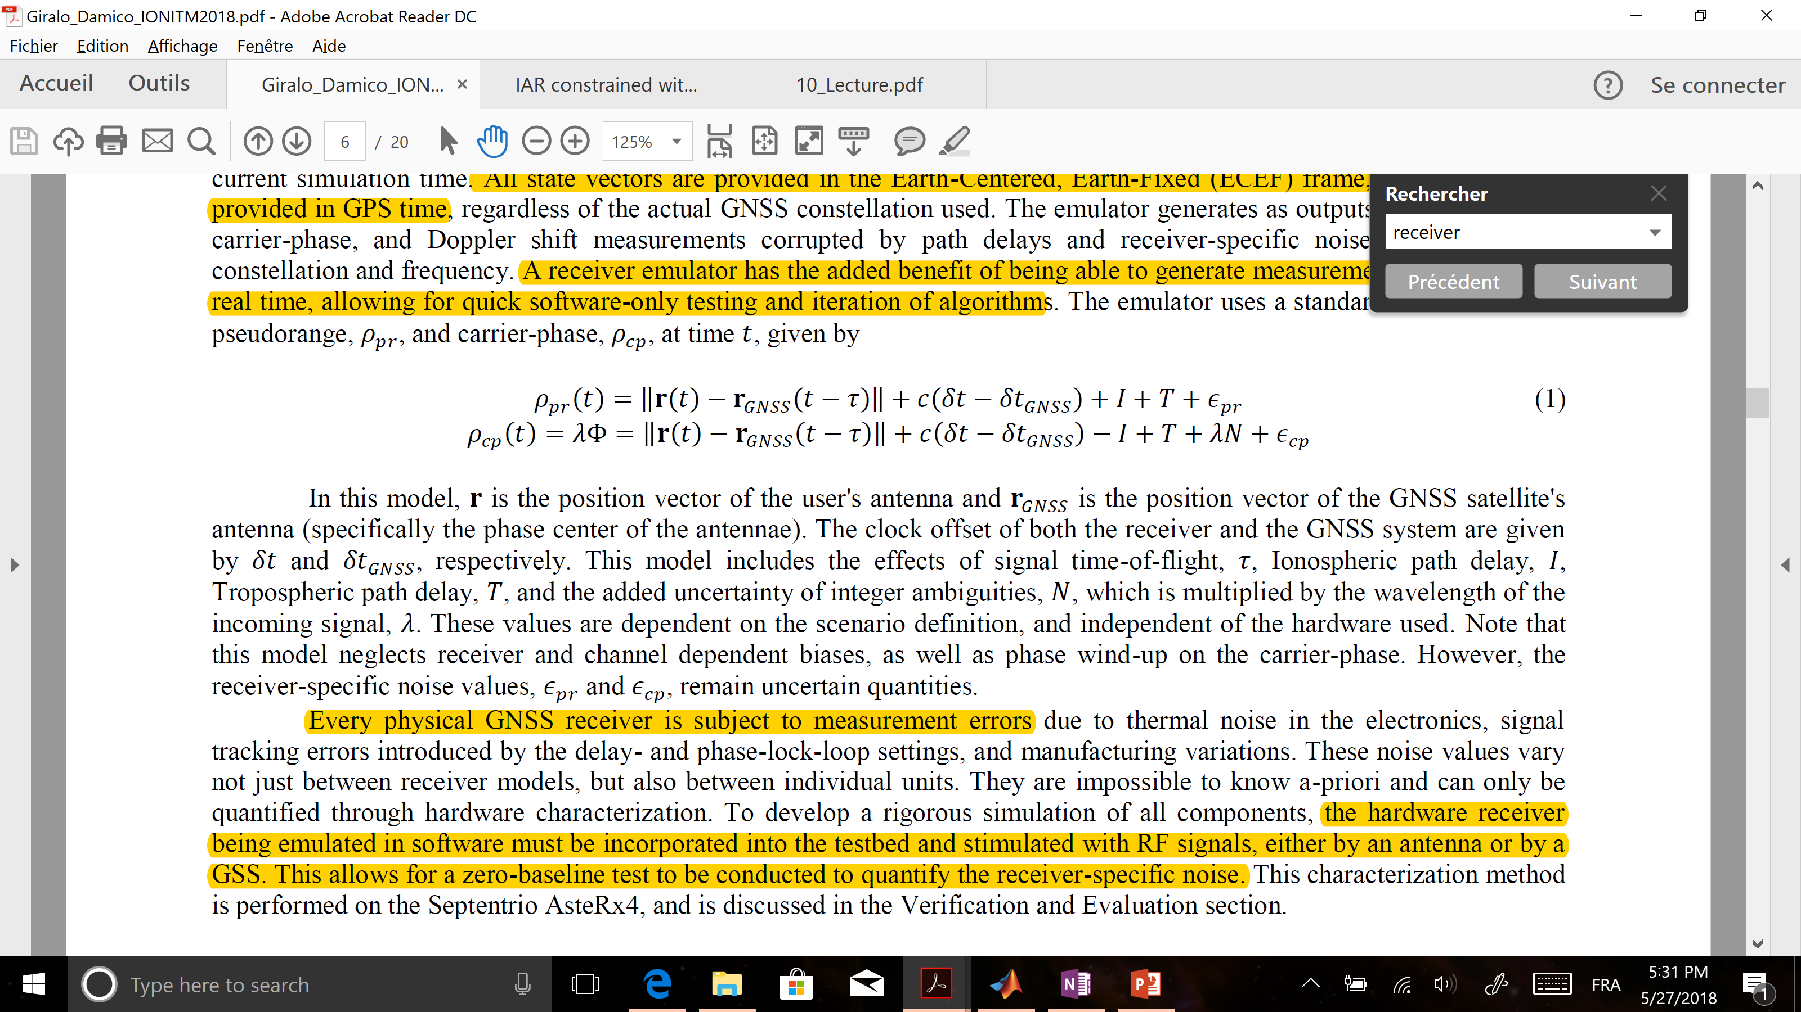
Carrier phase
Notes:
A good analogy to this is to imagine a measuring tape extending from the satellite to the receiver that has numbered markers every one millimeter. Unfortunately, however, the numbering scheme returns to zero with every wavelength

Slide 7
Carrier phase
Key to mm level accuracy is the correct fixing of integer ambiguities
Notes:
A good analogy to this is to imagine a measuring tape extending from the satellite to the receiver that has numbered markers every one millimeter. Unfortunately, however, the numbering scheme returns to zero with every wavelength

Slide 8
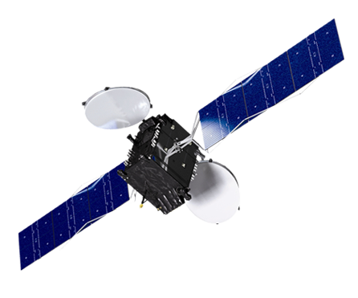

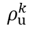
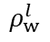
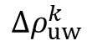
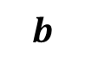
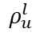
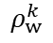
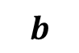
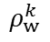
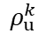
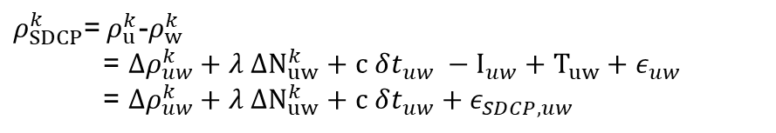
Differenced carrier phase
Single differenced (GNSS clock bias removed)
Double differenced (GNSS+receivers clock bias removed)
$ρ_{SDCP}^{k}$=${ ρ}_{u}^{k}$-$ρ_{w}^{k}$
= $Δρ_{uw}^{k}+λ ΔN_{uw}^{k}+c δt_{uw} −I_{uw}+T_{uw}+ε_{uw}$
= $Δρ_{uw}^{k}+λ ΔN_{uw}^{k}+c δt_{uw}+ε_{SDCP,uw}$
$ρ_{DDCP}^{kl}$=${ ρ}_{uw}^{kl}$-$ρ_{uw}^{kl}$= $ΔΔρ_{uw}^{kl}+λ ΔΔN_{uw}^{kl}+ε_{DDCP,uw}$
GNSS Satellite k
GNSS Satellite l
GNSS Satellite k
$$ρ_{w}^{k}$$
$$ρ_{u}^{k}$$
$$ρ_{w}^{k}$$
$$ρ_{u}^{l}$$
$$ρ_{u}^{k}$$
$$ρ_{w}^{l}$$
$$Δρ_{uw}^{k}$$
$$b$$
$$b$$
Antenna u
Antenna w
Antenna u
Antenna w

Slide 9
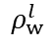
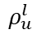
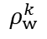
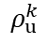
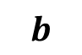
Differenced carrier phase
Double differenced
GNSS Satellite k
GNSS Satellite l
$ρ_{DDCP}^{kl}$= $ΔΔρ_{uw}^{kl}+λ ΔΔN_{uw}^{kl}+ε_{DDCP,uw}$
$$ρ_{w}^{k}$$
$$ρ_{u}^{k}$$
$$ρ_{u}^{l}$$
$$ρ_{w}^{l}$$
$$b$$
Antenna u
Antenna w

Slide 10


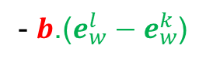

Differenced carrier phase
Double differenced
Satellite k
Satellite l
- $b$.($e_{w}^{l}−e_{w}^{k}$)
$ρ_{DDCP}^{kl}$= $ΔΔρ_{uw}^{kl}+λ ΔΔN_{uw}^{kl}+ε_{DDCP,uw}$
$$ρ_{w}^{k}$$
$$ρ_{u}^{k}$$
$$ρ_{u}^{l}$$
$$ρ_{w}^{l}$$
$$e_{w}^{l}$$
$$e_{w}^{k}$$
$$b$$
Antenna u
Antenna w

Slide 11
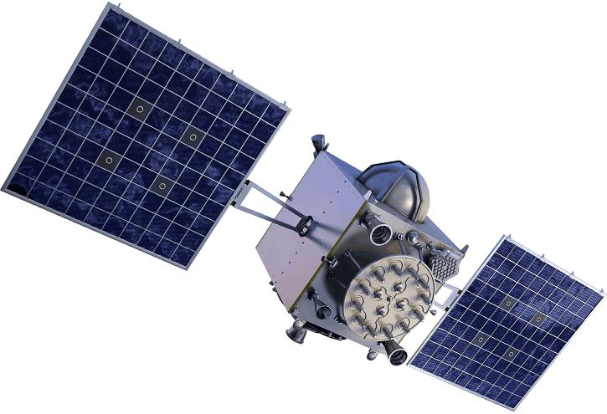
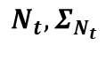
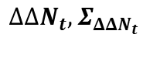
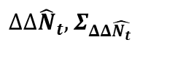
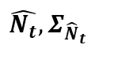
Problem statement
GPS satellites
Carrier phase
Pseudo-range
Navigation EKF
$$ΔΔ{\hat{N}}_{t},Σ_{ΔΔ\hat{N_{t}}}$$
Integer ambiguity resolution
$$\hat{N_{t}},Σ_{{\hat{N}}_{t}}$$
$$ΔΔN_{t},Σ_{ΔΔN_{t}}$$
Transformation
Transformation
$$N_{t},Σ_{N_{t}}$$
Notes:
IAR at every timestep

Slide 12
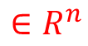
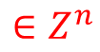
Problem statement
GPS satellites
Carrier phase
Pseudo-range
Navigation EKF
$$ΔΔ{\hat{N}}_{t},Σ_{ΔΔ\hat{N_{t}}}$$
Integer ambiguity resolution
$$\hat{N_{t}},Σ_{{\hat{N}}_{t}}$$
$$ΔΔN_{t},Σ_{ΔΔN_{t}}$$
Transformation
Transformation
$$∈R^{n}$$
$$∈Z^{n}$$
$$N_{t},Σ_{N_{t}}$$
Notes:
IAR at every timestep

Slide 13

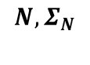
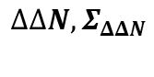
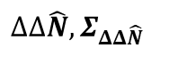
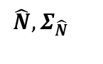

Problem statement
GPS satellites
$$ρ_{DDCP}$$
Carrier phase
Pseudorange
Navigation EKF
$$ΔΔ\hat{N},Σ_{ΔΔ\hat{N}}$$
Integer ambiguity resolution
$$\hat{N},Σ_{\hat{N}}$$
$$ΔΔN,Σ_{ΔΔN}$$
Transformation
Transformation
$$∈R^{n}$$
$$∈Z^{n}$$
$$\hat{b}$$
$$N,Σ_{N}$$
How to leverage a priori information on the baseline $b$ to aid the IAR ?

Slide 14
Table of contents
Introduction and Problem statement
The integer ambiguity resolution
Constrained integer ambiguity resolution
Results
Conclusion – Ways forward

Slide 15
The basic integer ambiguity resolution
Steps
( Obtain a real valued estimate of $a$ : $\hat{a}∈R^{n}$ )

Slide 16
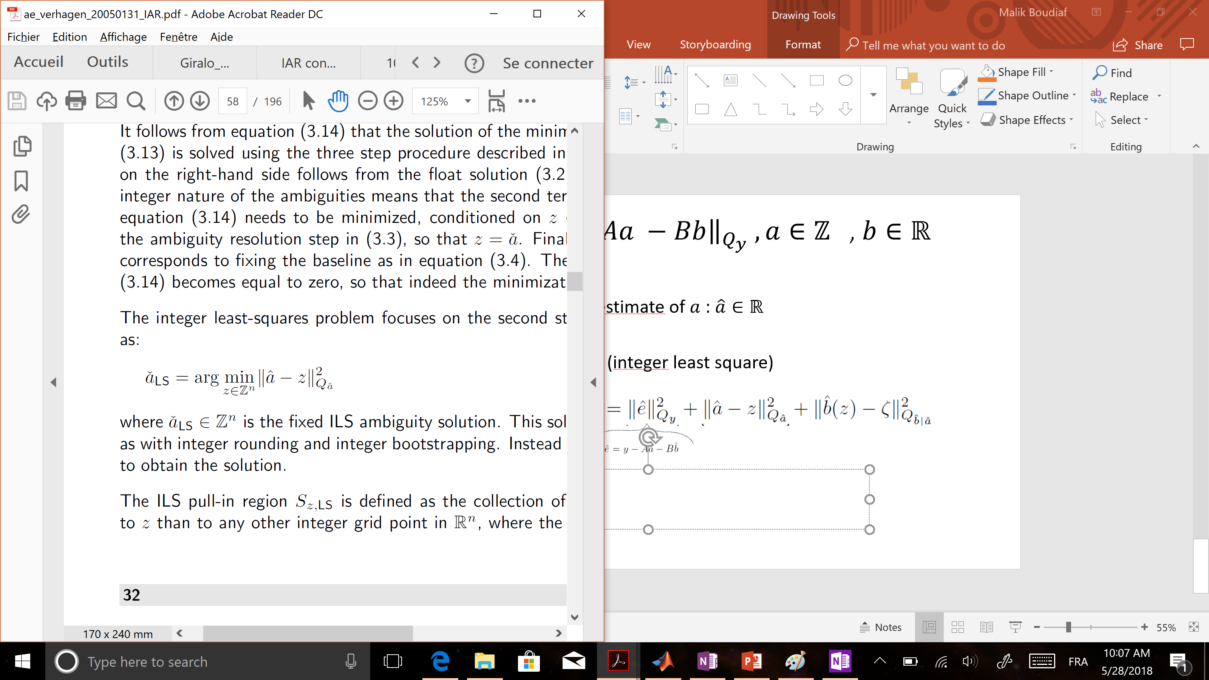
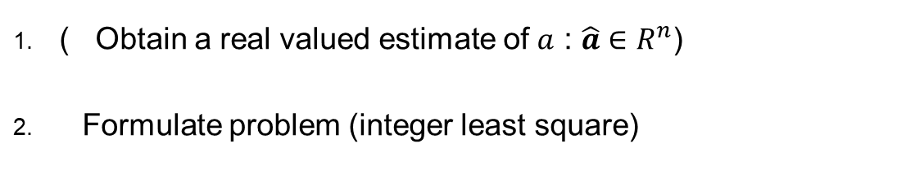
The basic integer ambiguity resolution
Steps
( Obtain a real valued estimate of $a$ : $\hat{a}∈R^{n}$)
Formulate problem (integer least square)

Slide 17
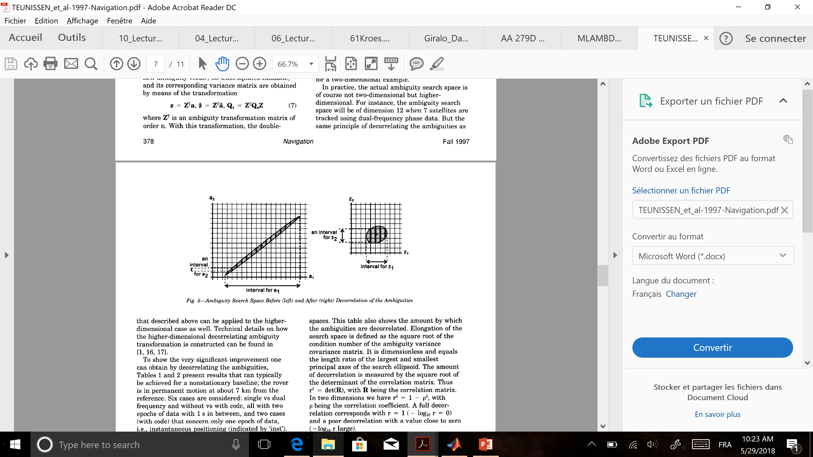
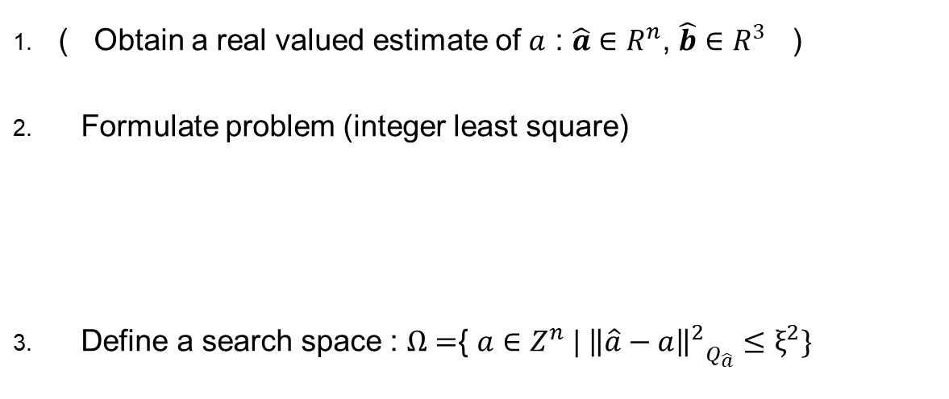
The basic integer ambiguity resolution
Steps
( Obtain a real valued estimate of $a$ : $\hat{a}∈R^{n}$, $\hat{b}∈R^{3}$ )
Formulate problem (integer least square)
Define a search space : $Ω=${ $a∈Z^{n} | {{\left\|\hat{a}−a\right\|}^{2}}_{Q_{\hat{a}}}≤ξ^{2}\}$
Teunissen, 1995 LAMBDA method

Slide 18
The basic integer ambiguity resolution
Steps
( Obtain a real valued estimate of $a$ : $\hat{a}∈R^{n}$, $\hat{b}∈R^{3}$ )
Formulate problem (integer least square)
Define a search space : $Ω=${ $a∈Z^{n} | {{\left\|\hat{a}−a\right\|}^{2}}_{Q_{\hat{a}}}≤ξ^{2}\}$
$ξ^{2}$ defines size of search space

Slide 19
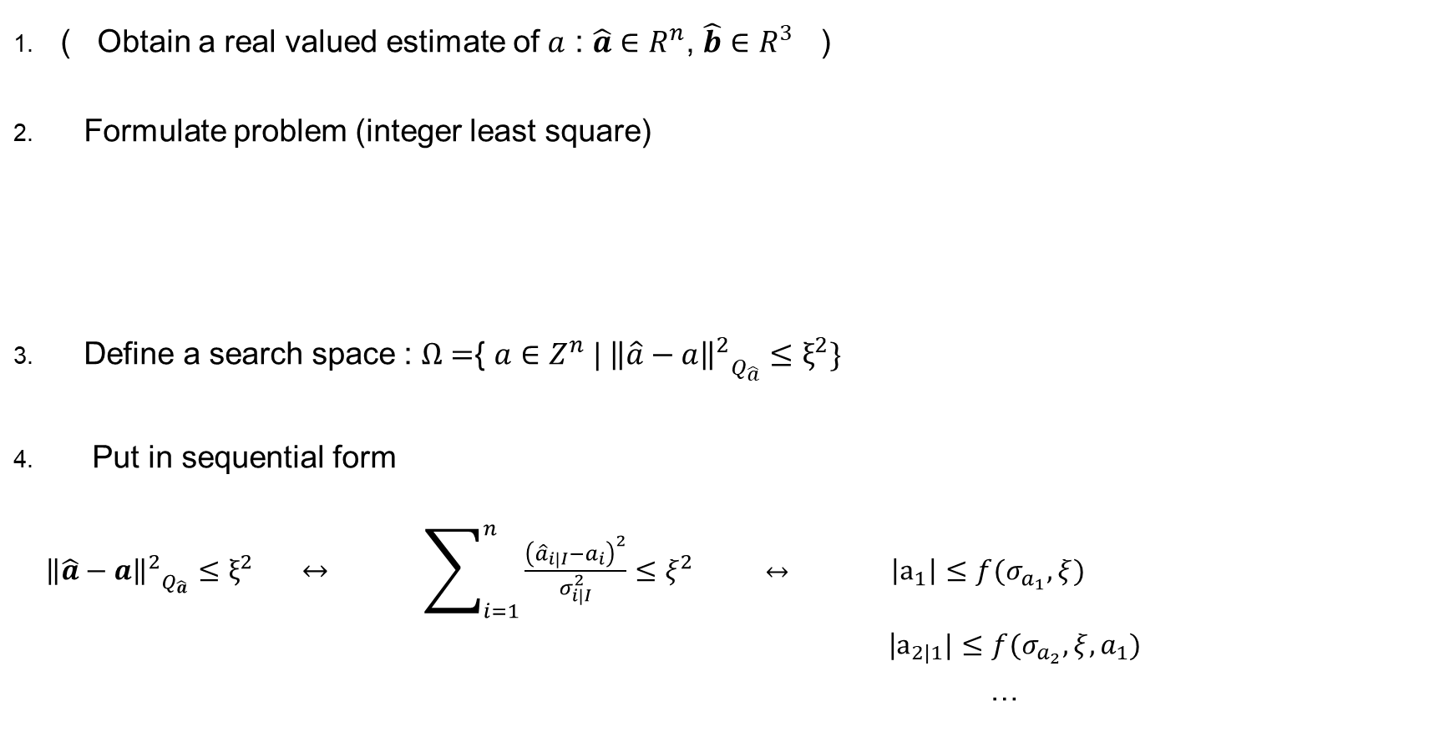
The basic integer ambiguity resolution
Steps
( Obtain a real valued estimate of $a$ : $\hat{a}∈R^{n}$, $\hat{b}∈R^{3}$ )
Formulate problem (integer least square)
Define a search space : $Ω=${ $a∈Z^{n} | {{\left\|\hat{a}−a\right\|}^{2}}_{Q_{\hat{a}}}≤ξ^{2}\}$
Put in sequential form
${{\left\|\hat{a}−a\right\|}^{2}}_{Q_{\hat{a}}}≤ξ^{2} ↔ \sum_{i=1}^{n}{\frac{{\left({\hat{a}}_{i|I}−a_{i}\right)}^{2}}{σ_{i|I}^{2}}}≤ξ^{2}$ $↔$ $\left|a_{1}\right|≤f(σ_{a_{1}},ξ)$
|$a_{2|1}|≤f(σ_{a_{2}},ξ,a_{1})$
…
n inequalities
1 for each ambiguity to fix

Slide 20
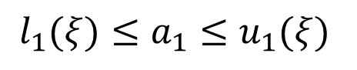
The basic integer ambiguity resolution
5. Search for candidates
$$l_{1}(ξ)≤a_{1}≤u_{1}(ξ)$$

Slide 21
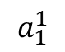
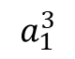
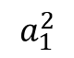
The basic integer ambiguity resolution
5. Search for candidates
$$l_{1}(ξ)≤a_{1}≤u_{1}(ξ)$$
$$a_{1}^{1}$$
$$a_{1}^{2}$$
$$a_{1}^{3}$$

Slide 22
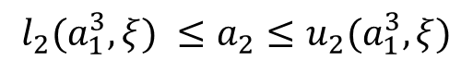
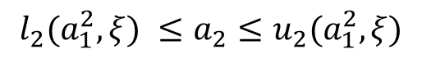
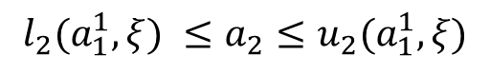
The basic integer ambiguity resolution
5. Search for candidates
$$l_{1}(ξ)≤a_{1}≤u_{1}(ξ)$$
$$a_{1}^{1}$$
$$a_{1}^{2}$$
$$a_{1}^{3}$$
$$l_{2}(a_{1}^{1},ξ) ≤a_{2}≤u_{2}(a_{1}^{1},ξ)$$
$$l_{2}(a_{1}^{2},ξ) ≤a_{2}≤u_{2}(a_{1}^{2},ξ)$$
$$l_{2}(a_{1}^{3},ξ) ≤a_{2}≤u_{2}(a_{1}^{3},ξ)$$

Slide 23
The basic integer ambiguity resolution
5. Search for candidates
$$l_{1}(ξ)≤a_{1}≤u_{1}(ξ)$$
$$a_{1}^{1}$$
$$a_{1}^{2}$$
$$a_{1}^{3}$$
$$l_{2}(a_{1}^{1},ξ) ≤a_{2}≤u_{2}(a_{1}^{1},ξ)$$
$$l_{2}(a_{1}^{2},ξ) ≤a_{2}≤u_{2}(a_{1}^{2},ξ)$$
$$l_{2}(a_{1}^{3},ξ) ≤a_{2}≤u_{2}(a_{1}^{3},ξ)$$
.. .. .. ..
.. .. .. .. .. .. ..

Slide 24
The basic integer ambiguity resolution
5. Search for candidates
$$l_{1}(ξ)≤a_{1}≤u_{1}(ξ)$$
$$a_{1}^{1}$$
$$a_{1}^{2}$$
$$a_{1}^{3}$$
$$l_{2}(a_{1}^{1},ξ) ≤a_{2}≤u_{2}(a_{1}^{1},ξ)$$
$$l_{2}(a_{1}^{2},ξ) ≤a_{2}≤u_{2}(a_{1}^{2},ξ)$$
$$l_{2}(a_{1}^{3},ξ) ≤a_{2}≤u_{2}(a_{1}^{3},ξ)$$
n levels
.. .. .. ..
.. .. .. .. .. .. ..
Width ?

Slide 25
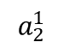
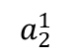
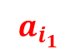
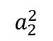
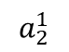
The basic integer ambiguity resolution
5. Search for candidates
$$l_{1}(ξ)≤a_{1}≤u_{1}(ξ)$$
$$a_{1}^{1}$$
$$a_{1}^{2}$$
$$a_{1}^{3}$$
$$l_{2}(a_{1}^{1},ξ) ≤a_{2}≤u_{2}(a_{1}^{1},ξ)$$
$$l_{2}(a_{1}^{2},ξ) ≤a_{2}≤u_{2}(a_{1}^{2},ξ)$$
$$l_{2}(a_{1}^{3},ξ) ≤a_{2}≤u_{2}(a_{1}^{3},ξ)$$
$$a_{2}^{1}$$
$$a_{2}^{1}$$
$$a_{2}^{1}$$
$$a_{2}^{2}$$
n levels
.. .. .. ..
.. .. .. .. .. .. ..
$$a_{i_{1}}$$
6. Select best candidate $a_{LS}∈N^{n}$ with minimum ${{\left\|\hat{a}−a_{i}\right\|}^{2}}_{Q_{\hat{a}}}$

Slide 26
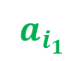
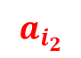
The basic integer ambiguity resolution
5. Search for candidates
$$l_{1}(ξ)≤a_{1}≤u_{1}(ξ)$$
$$a_{1}^{1}$$
$$a_{1}^{2}$$
$$a_{1}^{3}$$
$$l_{2}(a_{1}^{1},ξ) ≤a_{2}≤u_{2}(a_{1}^{1},ξ)$$
$$l_{2}(a_{1}^{2},ξ) ≤a_{2}≤u_{2}(a_{1}^{2},ξ)$$
$$l_{2}(a_{1}^{3},ξ) ≤a_{2}≤u_{2}(a_{1}^{3},ξ)$$
$$a_{2}^{1}$$
$$a_{2}^{1}$$
$$a_{2}^{1}$$
$$a_{2}^{2}$$
n levels
.. .. .. ..
.. .. .. .. .. .. ..
$$a_{i_{1}}$$
$$a_{i_{2}}$$
6. Select best candidate $a_{LS}∈N^{n}$ with minimum ${{\left\|\hat{a}−a_{i}\right\|}^{2}}_{Q_{\hat{a}}}$

Slide 27





The basic integer ambiguity resolution
Overview
$$\hat{N}$$
$N$
IAR
$$Q_{\hat{N}}$$
$$Q_{N}$$
(Potentially intractable tree seach)
Process relies exclusively on $\hat{N }$
Very dependent on quality of estimate $\hat{N }$ at epoch
Still exhibits wrong fixing

Slide 28
Table of contents
Introduction and Problem statement
The integer ambiguity resolution
Constrained integer ambiguity resolution
Results
Conclusion – Ways forward

Slide 29


The modified integer ambiguity resolution
$$ρ_{DDCP}$$
$$\hat{N}$$
$N$
IAR
$$Q_{\hat{N}}$$
$$Q_{N}$$
b
Now assume we have information on the baseline $b$: how can we leverage that information ?
Baseline $b$ = relative position + attitude information

Slide 30

Direct fixing
If $\left\|b_{est}−b_{true}\right\|<\frac{λ}{4} (\sim 5 cm for L1)$
We can directly fix the ambiguities

Slide 31



Direct fixing
If $\left\|b_{est}−b_{true}\right\|<\frac{λ}{4} (\sim 5 cm for L1)$
We can directly fix the ambiguities
$ρ_{DDCP }^{kl}$= $ΔΔρ_{uw}^{kl}+λΔΔN_{uw}^{kl}+ε_{DDCP,uw}$
= - $b$.($e_{w}^{l}−e_{w}^{k}$) + $λΔΔN_{uw}^{kl}+ε_{DDCP,uw}$
Satellite k
Satellite l
$$ρ_{w}^{k}$$
$$ρ_{u}^{l}$$
$$ρ_{w}^{l}$$
$$b$$

Slide 32

Direct fixing
If $\left\|b_{est}−b_{true}\right\|<\frac{λ}{4} (\sim 5 cm for L1)$
We can directly fix the ambiguities
$ρ_{DDCP }^{kl}$= $ΔΔρ_{uw}^{kl}+λ ΔΔN_{uw}^{kl}+ε_{DDCP,uw}$
= - $b$.($e_{w}^{l}−e_{w}^{k}$) + $λ ΔΔN_{uw}^{kl}+ε_{DDCP,uw}$
$ΔΔN_{uw,est}^{kl}=$ $\frac{1}{λ}{(ρ}_{DDCP }^{kl}+b\text{.(}e_{w}^{l}−e_{w}^{k}\text{)}{+ ε}_{DDCP,uw})$
Satellite k
Satellite l
$$ρ_{w}^{k}$$
$$ρ_{u}^{l}$$
$$ρ_{w}^{l}$$
$$b$$

Slide 33
Direct fixing
If $\left\|b_{est}−b_{true}\right\|<\frac{λ}{4} (\sim 5 cm for L1)$
We can directly fix the ambiguities
$ρ_{DDCP }^{kl}$= $ΔΔρ_{uw}^{kl}+λΔΔN_{uw}^{kl}+ε_{DDCP,uw}$
= - $b$.($e_{w}^{l}−e_{w}^{k}$) + $λΔΔN_{uw}^{kl}+ε_{DDCP,uw}$
$ΔΔN_{uw,est}^{kl}=$ $\frac{1}{λ}{(ρ}_{DDCP }^{kl}+b\text{.(}e_{w}^{l}−e_{w}^{k}\text{)}{+ ε}_{DDCP,uw})$
Satellite k
Satellite l
$$ρ_{w}^{k}$$
$$ρ_{u}^{l}$$
$$ρ_{w}^{l}$$
$$b$$

Slide 34




Direct fixing
If $\left\|b_{est}−b_{true}\right\|<\frac{λ}{4} (\sim 5 cm for L1)$
We can directly fix the ambiguities
$ρ_{DDCP }^{kl}$= $ΔΔρ_{uw}^{kl}+λΔΔN_{uw}^{kl}+ε_{DDCP,uw}$
= - $b$.($e_{w}^{l}−e_{w}^{k}$) + $λΔΔN_{uw}^{kl}+ε_{DDCP,uw}$
$ΔΔN_{uw,est}^{kl}=$ $\frac{1}{λ}{(ρ}_{DDCP }^{kl}+b\text{.(}e_{w}^{l}−e_{w}^{k}\text{)}{+ ε}_{DDCP,uw})$
Satellite k
$$\hat{N}$$
Satellite l
$$N−1$$
$$N$$
$$N+1$$
$$ρ_{w}^{k}$$
$$ρ_{u}^{l}$$
$$ρ_{w}^{l}$$
$$b$$

Slide 35

Direct fixing
If $\left\|b_{est}−b_{true}\right\|<\frac{λ}{4} (\sim 5 cm for L1)$
We can directly fix the ambiguities
$ρ_{DDCP }^{kl}$= $ΔΔρ_{uw}^{kl}+λΔΔN_{uw}^{kl}+ε_{DDCP,uw}$
= - $b$.($e_{w}^{l}−e_{w}^{k}$) + $λΔΔN_{uw}^{kl}+ε_{DDCP,uw}$
$ΔΔN_{uw,est}^{kl}=$ $\frac{1}{λ}{(ρ}_{DDCP }^{kl}+b\text{.(}e_{w}^{l}−e_{w}^{k}\text{)}{+ ε}_{DDCP,uw})$
Satellite k
$$\hat{N}$$
Satellite l
$$N−1$$
$$N$$
$$N+1$$
$$ρ_{w}^{k}$$
$$ρ_{u}^{l}$$
$$ρ_{w}^{l}$$
$$b$$

Slide 36

Direct fixing
If $\left\|b_{est}−b_{true}\right\|<\frac{λ}{4} (\sim 5 cm for L1)$
We can directly fix the ambiguities
$ρ_{DDCP }^{kl}$= $ΔΔρ_{uw}^{kl}+λΔΔN_{uw}^{kl}+ε_{DDCP,uw}$
= - $b$.($e_{w}^{l}−e_{w}^{k}$) + $λΔΔN_{uw}^{kl}+ε_{DDCP,uw}$
$ΔΔN_{uw,est}^{kl}=$ $\frac{1}{λ}{(ρ}_{DDCP }^{kl}+b\text{.(}e_{w}^{l}−e_{w}^{k}\text{)}{+ ε}_{DDCP,uw})$
Satellite k
$$\hat{N}$$
Satellite l
$$N−1$$
$$N$$
$$N+1$$
$$ρ_{w}^{k}$$
|$Err\left(ΔΔN_{uw,est}^{kl}\right)|≅|$ $\frac{{(b}_{est}−b_{true}\text{)}\text{.(}e_{w}^{l}−e_{w}^{k}\text{)}}{λ}$ |
$≤$ |$\frac{{(b}_{est}−b_{true}\text{)}\text{.(}e_{w}^{l}−e_{w}^{k}\text{)}}{λ}$|
$≤\frac{{‖(b}_{est}−b_{true}\text{)}‖. ‖\text{(}e_{w}^{l}−e_{w}^{k}\text{)}‖}{λ}$
$≤\frac{2}{λ}{‖(b}_{est}−b_{true}\text{)}‖ ≤ \frac{1}{2}$
$$ρ_{u}^{l}$$
$$ρ_{w}^{l}$$
$$b$$

Slide 37

Constrained IAR
The unconstrained minimization problem :
Now let’s assume we have some a priori information on the baseline’s length :
$$\left\|b_{est}\right\|=l \sim N\left(\hat{l},σ_{\hat{l}}\right)$$

Slide 38




Constrained IAR
Overview
Float estimate (from filter)
A priori information on $b$
$$\{\hat{l} , σ_{\hat{l}}\}$$
$$\hat{a}∈R^{n}$$
Integer search with constraints
$$\{a_{i}, l(a_{i})\}$$
Derivation of optimal $a∈N^{n}$

Slide 39


Modified Integer search
Principle
Start with a belief on the baseline
At each level k , derive integers that lie
within classic bounds
For these potentially valid integers, derive an updated estimate of the baseline
$b_{est,k} =b_{est,k−1}+K_{k}(\left(\begin{aligned}y_{1} \\ … \\ y_{k}\end{aligned}\right) −H_{k}\left(\begin{aligned}\begin{aligned}b_{est,k−1} \\ N_{1}\end{aligned} \\ … \\ N_{k}\end{aligned}\right)$)
$\left\|b_{est,k}\right\|$far from ${‖b}_{est,1}‖$? If yes, remove branch

Slide 40

Modified Integer search
Criteria to remove a branch
$b_{est,k}$new estimate at level k :
Derive $l_{est}={‖b}_{est,k}‖$
If $\left| l_{est}−l_{ref}\right|>η σ_{l}$ remove branch
Prefactor
Final selection
Derivation of $a∈N^{n}$ with minimum${{\left\|\hat{a}−a_{i}\right\|}^{2}}_{Σ_{\hat{a}}}+{k(σ_{l_{ref}})\left( l\left(a_{i}\right)−l_{ref}\right)}^{2}$

Slide 41
Table of contents
Introduction and Problem statement
The integer ambiguity resolution
Constrained integer ambiguity resolution
Results
Conclusion – Ways forward

Slide 42


Constrained IAR
Scenario
Analysis
2 spacecraft in LEO $\sim 700 km altitude$
Short separation : $\sim 340 m$
GNSS receivers on each spacecraft : 36 channels, GPS only (IFEN emulator)
GPS antennas assumed at CoM
Implementation on Digital’s Navigation filter
Analysis of the IAR initialization
9 GPS satellites in view $→$ 9 ambiguities to fix
Sensitive step
- no ambiguities fixed yet : reference is arbitrary
Crucial step
- once ambiguities fixed , they are kept constant
- fixed ambiguities serve as reference for future fixing

Slide 43



Constrained IAR
Constrained IAR
Results for the tree search
If $\left| l_{est}−l_{ref}\right|>η σ_{l}$ remove branch

Slide 44


Constrained IAR
Constrained IAR
Results for the tree search
No candidates
$η$ too small
$$↔$$
We are certain our $l_{ref}$ is the truth
Accuracy on the baseline $\left|l_{ref}−l_{true}\right|≅30 cm$

Slide 45



Constrained IAR
Constrained IAR
Results for the tree search
What about with a better estimate $l_{ref}$
Higher accuracy
$$\left|l_{ref}−l_{true}\right|≅10 cm$$
$$η_{opt}$$

Slide 46

Constrained IAR
Constrained IAR
Comparison
IAR at different epochs
$η$ = 1 for all epochs
Comparison of my constrained IAR versus mLamda method

Slide 47

Constrained IAR
Constrained IAR
Comparison
IAR at different epochs
$η$ = 1 for all epochs
Comparison of my constrained IAR versus mLamda method

Slide 48
Table of contents
Introduction and Problem statement
The integer ambiguity resolution
Constrained integer ambiguity resolution
Results
Conclusion – Ways forward

Slide 49
Conclusions
Derivation of a new bound on baseline error for direct fixing
Derivation of a new integer search and cost function incorporating information on the baseline
Implementation on DiGiTal’s filter
Simulation of the process for one scenario only, at different epochs

Slide 50

Ways forward
1. Setup a rigorous experiment with statistical meaning to assess robustness/accuracy of constrained IAR
2. Include Z transformation in algorithm
3. Include a priori information on the baseline’s orientation : $b=l. r(ν_{1},ν_{2}$) $l \sim N\left(μ_{l},σ_{l}\right)$ ${ ν}_{1} \sim N\left(μ_{ν_{1}},σ_{ν_{1}}\right)$ $ν_{2}\sim N\left(μ_{ν_{2}},σ_{ν_{2}}\right)$
4. Further study on the choice of prefactor $η$

Slide 51
References
[1] S. D’Amico, Autonomous Formation Flying in Low Earth Orbit, 2010
[2] R. Kroes, Precise Relative Positioning of Formation Flying Spacecraft using GPS
[3] Sandra Verhagen, The GNSS integer ambiguities: estimation and validation, 2005
[4] X.-W. Chang, X. Yang, T. Zhou, MLAMBDA: A modified LAMBDA method for integer least-squares estimation
[5] PJG Teunissen, PJ De Jonge, CCJM Tiberius, Performance of the LAMBDA Method for Fast GPS Ambiguity Resolution, 1997
[6] V. Giralo, S. D’Amico, Development of the Stanford GNSS Navigation Testbed for Distributed Space Systems, 2018
[7] PJG Teunissen, Integer least-squares theory for the GNSS compass, 2010
[8] Patrick Henkel and Patryk Jurkowski, Reliable Integer Ambiguity Resolution, 2014
[9] P. Jurkowski, P. Henkel, G. X. Gao and C. G¨unther, Integer Ambiguity Resolution with Tight and Soft Baseline Constraints for Freight Stabilization at Helicopters and Cranes
[10] Patrick Henkel and Chen Zhu, Carrier phase integer ambiguity resolution with inequality constraints for GPS and Galileo

